Slide 1
Advanced Dial Plan and Routing for Webex Calling
2 Nov 2022
Fred Mollenkopf, Technical Solutions Architect Johannes Krohn, Principal Technical Marketing Engineer CTG

Slide 2
Advanced Dial Plan and Routing for Webex Calling
Agenda
Webex Calling Multi-Tenant Dial Plan Foundations - Fred
Webex Calling Multi-Tenant Routing Overview - Hannes
Webex Calling Multi-Tenant Caller Identity - Hannes
Interworking between Webex Calling and Unified CM on Premises - Fred
Special Case: Flat Extension Dialling
Interworking between Webex Calling and Dedicated Instance - Hannes
Cloud Connected PSTN for Dedicated Instance
Closing

Slide 3
Webex Calling Multi-Tenant Dial Plan Foundations

Slide 4
Webex Calling Multi-Tenant Dial Plan Foundations
Webex Calling dialing habits
Extension dialing: 2-6 digits (default 4)
Inter- and intra-site; inter-site requires unique extensions
ESN (Location routing prefix + user extension) using an optional location code: up to 7 digits
+E.164
Telephone numbers defined in the Webex Calling system. Always resolvable by +E164 dialing
Country Dial Plans
US, Canada, Puerto Rico:
National: 10 digit dialing or 1+10 digit dialing
7 digit dialing:
Webex Calling will normalize to E.164 for external calls assuming NPA of originator
Dial plans in phones not optimized for 7D dialing → timeout experienced when using off-hook dialing
Avoid conflict between abbreviated inter-site dialing (enterprise numbers) and 7D when integrating with PBX via Local Gateway; no 7D enterprise numbers
Other countries
Various digit lengths based on published national numbering plan

Slide 5
Webex Calling Multi-Tenant Dial Plan Foundations
Extension Dialing
Primary number has as a dedicated field for extension, along with the telephone number (+E164), and is an optional value if a telephone number is assigned
Extensions are assigned to a location and can be used to provide ease of dialing
Country specific dial plans have numbering that will take precedence over extension assignment, e.g. NANP - 411 cannot be an extension for a US assigned location
Extensions can overlap between different locations:
Within location takes precedence
Can dial remote location if non-overlap
Cannot disable extension lookup inter-location (e.g UCM partition approach)
On-premises may have caveats (Unknown routing with overlap)
Widgets, Inc.
LA
NY
Montreal
Alice
Bob
Charlie
Dave
4001
+13105554001
4002
+13105554002
6001
+12125556001
4002

Slide 6
Webex Calling Multi-Tenant Dial Plan Foundations
Understanding location routing prefixes
Allow for additional dialing behaviors for calling between locations using an ESN (Location routing prefix + user extension)
If you have multiple locations with the same extension, users must dial a prefix when calling between locations.
Prefixes can be a length of 2-7 digits. Optional steering digit should be used for extension conflict avoidance.
Used to align to existing UCM internal dial plans, either DN or Translation pattern defined
Widgets, Inc.
Location | Location Code
LA | 8201
NY | 8202
Montreal | 8251
LA
NY
Montreal
Alice
Bob
Charlie
Dave
4001
82014001
+13105554001
4002
82014002
+13105554002
6001
82026001
+12125556001
4002
82514002
+15145554002

Slide 7
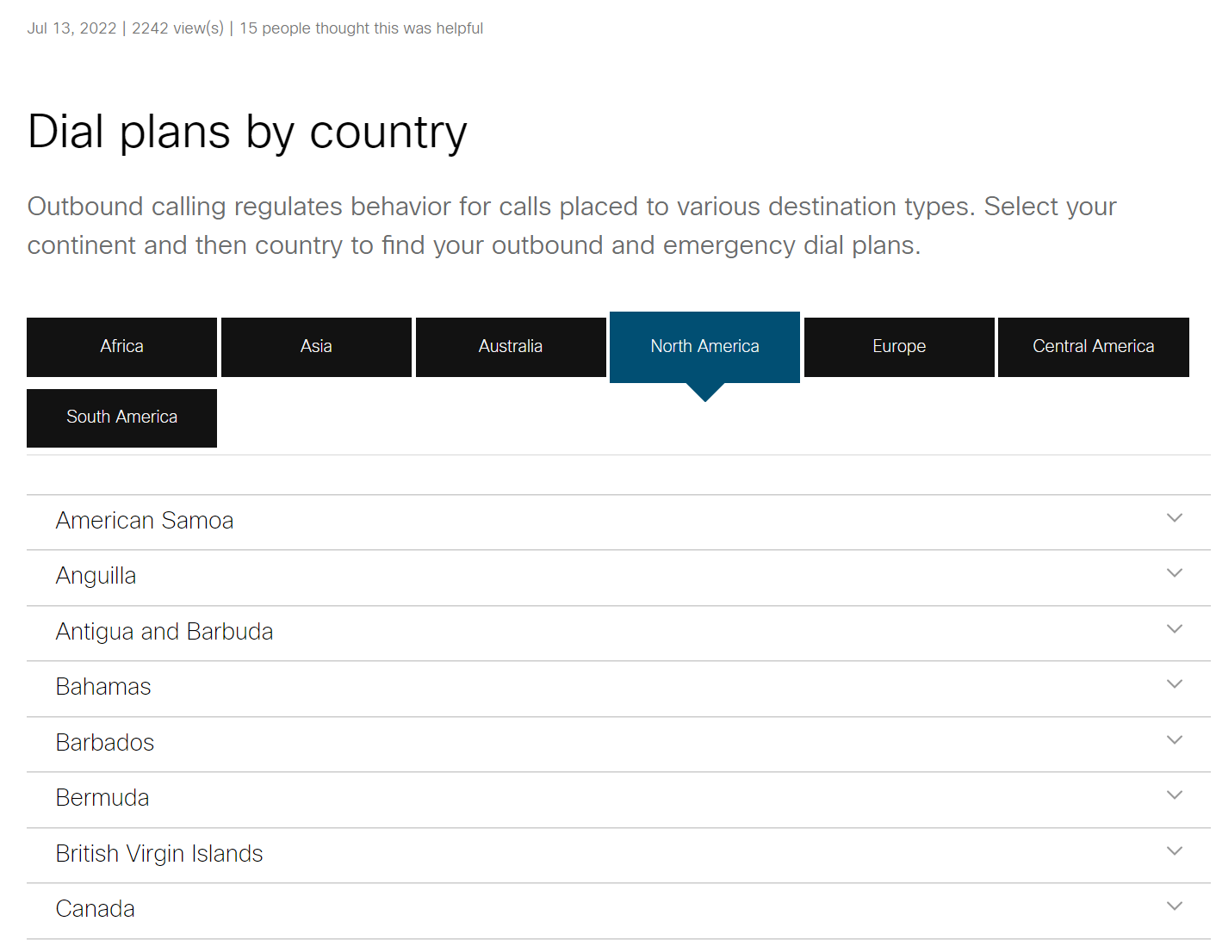
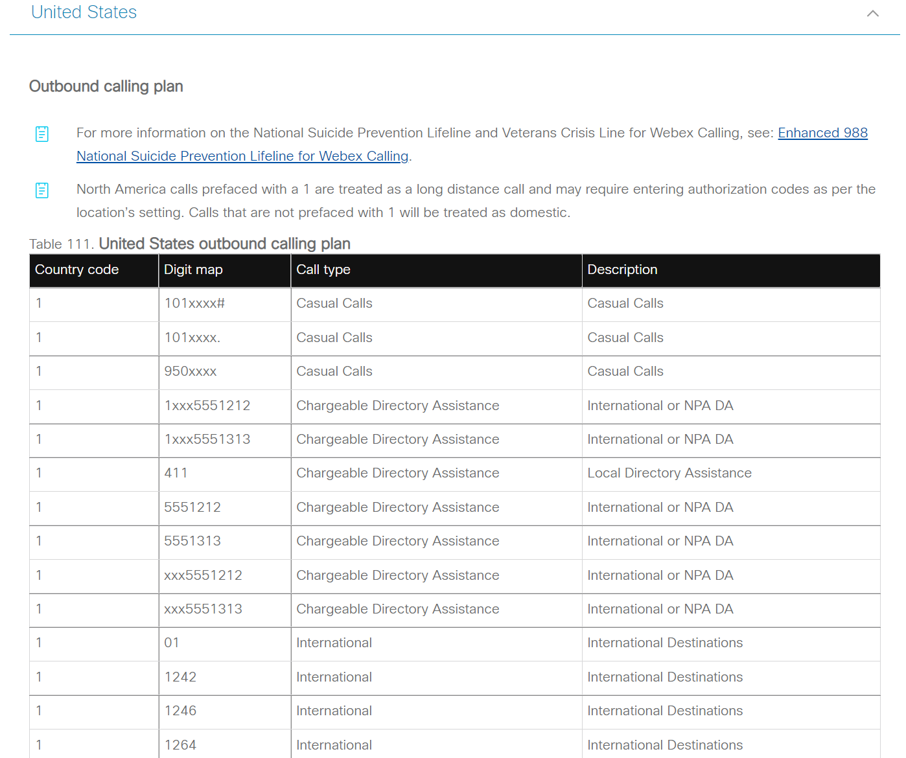
Webex Calling Multi-Tenant Dial Plan Foundations
Dial Plans by Country
The PSTN patterns available for dialing is dictated by the country type assigned for that location.
When the locations is created, a pre-loaded country dial plan is used for all devices within the location. This dial plan is reviewed and maintained by Cisco and is based off the ITU numbering plans.
Co-exists with telephone numbers defined on WxC org. Routing will be dependent on:
Webex Calling #s defined for this Organization - subscriber +E.164 will be matched and routed directly to the user.
No on-net match, the PSTN Connection is used to route any matched calls for these patterns.
https://help.webex.com/en-us/article/757iyo/Dial-plans-by-country

Slide 8
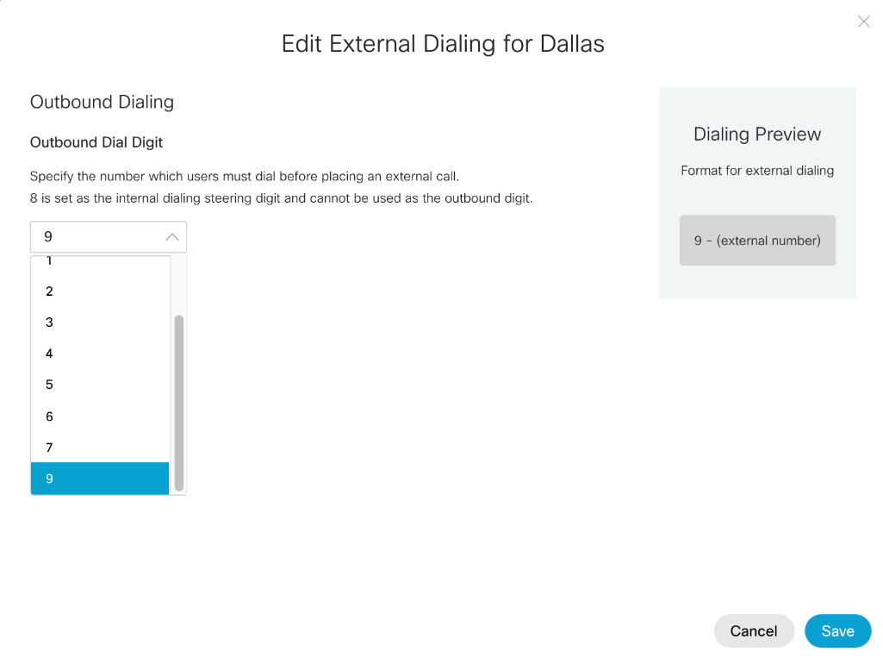
Webex Calling Multi-Tenant Dial Plan Foundations
Enterprise best practices
Goal: optimize dial plan handling in phones to minimize timeouts
Outbound dialing digit (for example 9)
Per location
Internal steering digit for inter-site (for example 8)
Different from PSTN
Uniform location code length (for example 4)
Location code includes leading internal steering digit!
Uniform extension length (for example 4)
Uniform inter-site dialing: steering digit – location id – extension
Example: 8-496-9764

Slide 9




Local Gateway
Webex Calling Multi-Tenant Dial Plan Foundations
Call Routing for PSTN
Cisco Calling Plans
(Cisco PSTN)
Cloud Connected PSTN Providers
Available in 110+ countries
Continue using your existing provider
Support remote branch offices
Manage phone numbers Control Hub
Available in the U.S., Canada, Europe, Australia and New Zealand
Single offer through Cisco and our partners
Fully integrated and managed from Control Hub
Available in over 65 countries
Select from multiple world-class Cisco-certified providers
Choose providers on a site-by-site basis
Manage numbers in Control Hub
PSTN
Access
Network
Peering
network
Cisco Calling Plans
CCPP
PSTN 1
Local
Gateway
CCPP
PSTN 2

Slide 10
Trunks
Webex Calling Multi-Tenant Dial Plan Foundations
Call Routing for On-Premise PBX & PSTN
Route groups
Dial Plans
Represents a single SIP Trunk to an on-premises device. Device can be registration based (CUBE) or MTLS based (CUBE + Future 3rd party)
Must be assigned to a Location. If used for PSTN the Country dial plan is based on location address.
Can be included in one or more Route Groups or can be directly associated to a Dial Plan.
Logical grouping of Trunks (max. 10) for scale and redundancy of connections to the premises
Does not “live” in a Location
Dial plans allow you to route calls to on-premises destinations by use of trunks or route groups.
Specifies the routing choice (trunk or route group) for calls that match any of its dial patterns.
Dial pattern represents on-premises extensions; ESN/on-net numbers, +E.164 patterns, SIP URI domains.
Trunk
CA PBX Dial Plan
+1408525XXXX
US East (Route Group)
8408XXXX
+1310444XXXX
Local Gateway
8310XXXX
us.foo.com

Slide 11
Webex Calling Multi-Tenant Dial Plan Foundations
Enterprise
PSTN connection options
Location NY
PSTN connection
Cisco PSTN or Cloud Connected PSTN
Location RTP
Note: Cloud Connected PSTN Providers are only accessible to Webex Calling users or Dedicated Instance, not premises PBX users.
No routing from trunk to PSTN
PSTN connection
CCPP 1
Location Dallas
CCPP 2
PSTN connection
Premises-based PSTN (Local Gateway)
Location SJC
SJ CUBE
Trunk SJ
#1
US West 1 Route Group
PSTN connection
#2
Location LA
US West 2 Route Group
PSTN connection
LA CUBE
Trunk LA
#1
#1
Location London
PSTN connection
#1
UK CUBE
Trunk UK
Location Glasgow
PSTN connection

Slide 12
Webex Calling Routing Overview

Slide 13
Webex Calling Multi-Tenant Routing Overview
Webex Calling call routing overview
Multiple phases
Source classification (PSTN, user, premises)
Based on source only
or in the case of trunks based on caller ID match on dial plan pattern
or for extensions as caller ID based on extension length and unknown extension dialling policy
Destination selection
Screening & Routing (User, Trunk/Route Group, PSTN)

Slide 14
Webex Calling Multi-Tenant Routing Overview
User dials number
Routing overview
Destination selection

Slide 15
Webex Calling Multi-Tenant Routing Overview
User dials number
Routing overview
Emergency
Yes
2
PSTN
Destination selection

Slide 16
Webex Calling Multi-Tenant Routing Overview
User dials number
Routing overview
Emergency
Yes
2
PSTN
Destination selection
User
Yes
2
User
E.164, ext, ESN
Test dialed number against +E.164, extension, and enterprise numbers of users within customer.
Exact match: “9011496100123” <> “+496100123”

Slide 17
Webex Calling Multi-Tenant Routing Overview
User dials number
Routing overview
Emergency
Yes
2
PSTN
Destination selection
User
Yes
2
User
E.164, ext, ESN
RL
Yes
2
RL
Strict match
VON
Yes
2
VON
Dial Plan
Yes
2
DP
Strict match
Strict match: ”914085550123“ does not match “+1408555!“

Slide 18
Webex Calling Multi-Tenant Routing Overview
User dials number
Routing overview
Emergency
Yes
2
PSTN
Destination selection
User
Yes
2
User
E.164, ext, ESN
RL
Yes
2
RL
Dialed number might be translated to +E.164 based on national numbering plan.
For example:
9011496100123 → +496100123
If number is translated, then go back to check for internal matches
Strict match
+E.164 translated
VON
Yes
2
VON
Dial Plan
Yes
2
DP
Strict match
NS lookup
Unknown number
Based on national dial plan
2
PSTN

Slide 19
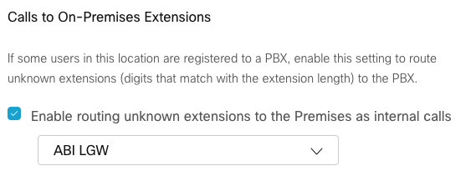
Webex Calling Multi-Tenant Routing Overview
User dials number
Routing overview
Emergency
Yes
2
PSTN
Destination selection
Unknown number handling
User
Yes
2
User
Unknown extension policy enabled and 2-6 dialed digits
E.164, ext, ESN
RL
Yes
2
RL
Strict match
?
Yes
2
+E.164 translated
Unknown ext.
VON
Yes
2
VON
Dial Plan
Yes
2
DP
Strict match
NS lookup
Unknown number
Based on national dial plan
2
PSTN

Slide 20

Webex Calling Multi-Tenant Routing Overview
User dials number
Routing overview
Emergency
Yes
2
PSTN
Destination selection
Unknown number handling
User
Yes
2
User
Unknown extension policy enabled and 2-6 dialed digits
E.164, ext, ESN
RL
Yes
2
RL
Strict match
?
Yes
2
+E.164 translated
Unknown ext.
VON
Yes
2
VON
Location PSTN
Cloud PSTN
Dial Plan
Yes
2
DP
prem PSTN
Strict match
NS lookup
Unknown number
Based on national dial plan
2
PSTN

Slide 21
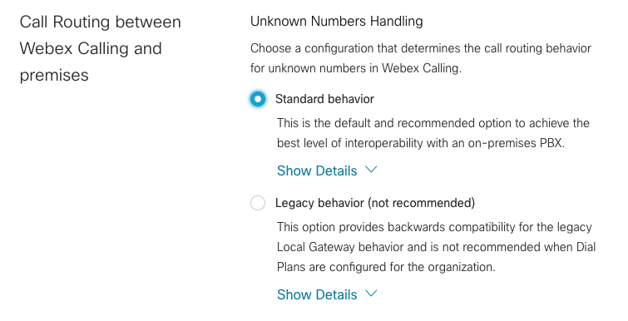
Webex Calling Multi-Tenant Routing Overview
User dials number
Routing overview
Emergency
Yes
2
PSTN
Destination selection
Block or allow based on calling permissions and route
Unknown number handling
User
Yes
2
User
Unknown extension policy enabled and 2-6 dialed digits
E.164, ext, ESN
RL
Yes
2
RL
Strict match
?
Yes
2
+E.164 translated
Unknown ext.
VON
Yes
2
VON
Location PSTN
Cloud PSTN
Dial Plan
Yes
2
DP
prem PSTN
Strict match
Unknown Number
Standard
NS lookup
Unknown number
Legacy
Based on national dial plan
2
2
Unknown ext.
PSTN

Slide 22
Webex Calling Multi-Tenant Routing Overview
User dials number
Routing overview
Emergency
Yes
2
PSTN
Destination selection
Block or allow based on calling permissions and route
Unknown number handling
User
Yes
2
User
Unknown extension policy enabled and 2-6 dialed digits
E.164, ext, ESN
2
RL
Yes
2
RL
Strict match
?
Yes
2
+E.164 translated
Unknown ext.
PSTN VON
VON
Yes
2
VON
Call Type
Based on dial-in numbers table
Location PSTN
Cloud PSTN
RL
DP unknown ext.
Meeting number
Yes
Dial Plan
Yes
2
DP
prem PSTN
User
Strict match
Unknown Number
No
Standard
Route to user
Route to Trunk/RG
Route to Location PSTN
Route to meetings SRV for location’s country
NS lookup
Unknown number
Legacy
Based on national dial plan
2
2
Unknown ext.
PSTN

Slide 23
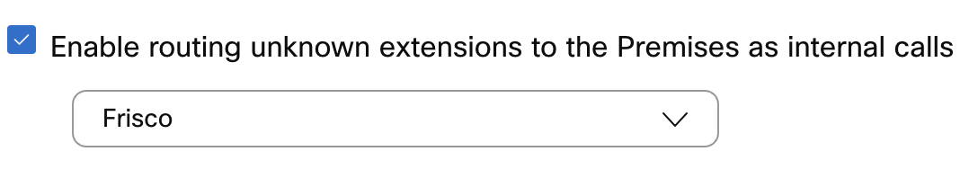
Webex Calling Multi-Tenant Routing Overview
Unknown* Number Incoming Call Handling
Calling Device/Number |  | Unknown Numbers Handling for Premises-based PSTN:
Device | Number | “Standard behavior” | “Legacy behavior”
Trunk | Unknown Extension (2-6 digits, e.g., 4099) | Premises | Premises
 |  | External
 | Other Unknown Number (e.g., 72349999) | External | Premises
“Enable routing unknown extensions to the Premises as internal calls” (location setting):
enabled
disabled
*unknown: caller id does not match any dial plan pattern or route list

Slide 24
Webex Calling Multi-Tenant Routing Overview
Unknown* Number Incoming Call Handling
Basically: call from any unknown number treated as premises call
Calling Device/Number |  | Unknown Numbers Handling for Premises-based PSTN:
Device | Number | “Standard behavior” | “Legacy behavior”
Trunk | Unknown Extension (2-6 digits, e.g., 4099) | Premises | Premises
 |  | External
 | Other Unknown Number (e.g., 72349999) | External | Premises
“Enable routing unknown extensions to the Premises as internal calls” (location setting):
enabled
disabled
*unknown: caller id does not match any dial plan pattern or route list

Slide 25
Webex Calling Multi-Tenant Routing Overview
Unknown* Number Incoming Call Handling
Classification of calls from extensions depends on location level setting for unknown extension dialing
Calling Device/Number |  | Unknown Numbers Handling for Premises-based PSTN:
Device | Number | “Standard behavior” | “Legacy behavior”
Trunk | Unknown Extension (2-6 digits, e.g., 4099) | Premises | Premises
 |  | External
 | Other Unknown Number (e.g., 72349999) | External | Premises
“Enable routing unknown extensions to the Premises as internal calls” (location setting):
enabled
disabled
*unknown: caller id does not match any dial plan pattern or route list

Slide 26
Webex Calling Multi-Tenant Routing Overview
Unknown* Number Incoming Call Handling
Classification of calls from extensions depends on location level setting for unknown extension dialing
Calling Device/Number |  | Unknown Numbers Handling for Premises-based PSTN:
Device | Number | “Standard behavior” | “Legacy behavior”
Trunk | Unknown Extension (2-6 digits, e.g., 4099) | Premises | Premises
 |  | External
 | Other Unknown Number (e.g., 72349999) | External | Premises
Note: “Enable routing unknown extensions to the Premises as internal calls” setting does not only affect routing of calls TO the premises but also treatment of calls FROM the premises
“Enable routing unknown extensions to the Premises as internal calls” (location setting):
enabled
disabled
*unknown: caller id does not match any dial plan pattern or route list

Slide 27
Webex Calling Multi-Tenant Routing Overview
Unknown Number Outgoing Call Handling
Call Types and Destinations |  | Unknown Numbers Handling for Premises-based PSTN:
From | To | “Standard behavior” | “Legacy behavior”
WxC | Unknown Extension (e.g., 4099) | Route to Premises
 |  | Block | Route to External
WxC | Other Unknown Number (e.g., 72359999) | Block | Route to External
Premises | Unknown Extension (e.g., 4099) | Route to Premises
 |  | Block
Premises | Other Unknown Number (e.g., 72359999) | Block
External | Any Unknown Number (e.g., 4099, 72359999) | Block
“Enable routing unknown extensions to the Premises as internal calls” (location setting):
enabled
disabled

Slide 28

Webex Calling Multi-Tenant Routing Overview
Screening and Routing
 | WxC User | Trunk (RL match) | Trunk (DP match) | Cloud PSTN (CCPP or Cisco)
WxC User
Trunk (RL match on CLID)
Trunk (prem user call)*
Trunk (prem PSTN call)*
Cloud PSTN (CCPP or Cisco)
To
To
From
*prem user vs PSTN: caller ID match on DP pattern, or extension (see prev. slides)

Slide 29
Webex Calling Multi-Tenant Routing Overview
Screening and Routing
 | WxC User | Trunk (RL match) | Trunk (DP match) | Cloud PSTN (CCPP or Cisco)
WxC User
Trunk (RL match on CLID)
Trunk (prem user call)*
Trunk (prem PSTN call)*
Cloud PSTN (CCPP or Cisco)
To
To
From
Calls from Webex Calling users can be routed everywhere
*prem user vs PSTN: caller ID match on DP pattern, or extension (see prev. slides)

Slide 30
Webex Calling Multi-Tenant Routing Overview
Screening and Routing
 | WxC User | Trunk (RL match) | Trunk (DP match) | Cloud PSTN (CCPP or Cisco)
WxC User
Trunk (RL match on CLID)
Trunk (prem user call)*
Trunk (prem PSTN call)*
Cloud PSTN (CCPP or Cisco)
To
To
From
Calls from DI users can be routed everywhere
*prem user vs PSTN: caller ID match on DP pattern, or extension (see prev. slides)

Slide 31
Webex Calling Multi-Tenant Routing Overview
Screening and Routing
 | WxC User | Trunk (RL match) | Trunk (DP match) | Cloud PSTN (CCPP or Cisco)
WxC User
Trunk (RL match on CLID)
Trunk (prem user call)*
Trunk (prem PSTN call)*
Cloud PSTN (CCPP or Cisco)
To
To
From
Call from premises classified as user call: no access to cloud PSTN (in contrast to call from DI user)
*prem user vs PSTN: caller ID match on DP pattern, or extension (see prev. slides)

Slide 32
Webex Calling Multi-Tenant Routing Overview
Screening and Routing
 | WxC User | Trunk (RL match) | Trunk (DP match) | Cloud PSTN (CCPP or Cisco)
WxC User
Trunk (RL match on CLID)
Trunk (prem user call)*
Trunk (prem PSTN call)*
Cloud PSTN (CCPP or Cisco)
To
To
From
Call from premises classified as PSTN call: no access to cloud PSTN nor other trunks; premises PSTN can only be used for premises users, DI users, and Webex Calling users, but not for premises users in other sites
*prem user vs PSTN: caller ID match on DP pattern, or extension (see prev. slides)

Slide 33
Webex Calling Multi-Tenant Routing Overview
Screening and Routing
 | WxC User | Trunk (RL match) | Trunk (DP match) | Cloud PSTN (CCPP or Cisco)
WxC User
Trunk (RL match on CLID)
Trunk (prem user call)*
Trunk (prem PSTN call)*
Cloud PSTN (CCPP or Cisco)
To
To
From
Cloud PSTN can only be used for Webex Calling users and DI users, but not for premises users
*prem user vs PSTN: caller ID match on DP pattern, or extension (see prev. slides)

Slide 34
Webex Calling Multi-Tenant Routing Overview
Screening and Routing
No tandem between premises (user and PSTN) and Cloud PSTN
 | WxC User | Trunk (RL match) | Trunk (DP match) | Cloud PSTN (CCPP or Cisco)
WxC User
Trunk (RL match on CLID)
Trunk (prem user call)*
Trunk (prem PSTN call)*
Cloud PSTN (CCPP or Cisco)
To
To
From
*prem user vs PSTN: caller ID match on DP pattern, or extension (see prev. slides)

Slide 35
Webex Calling Multi-Tenant Routing Overview
On-premises users behind trunks cannot use Cloud PSTN, DI users can
Screening and Routing
 | WxC User | Trunk (RL match) | Trunk (DP match) | Cloud PSTN (CCPP or Cisco)
WxC User
Trunk (RL match on CLID)
Trunk (prem user call)*
Trunk (prem PSTN call)*
Cloud PSTN (CCPP or Cisco)
To
To
From
*prem user vs PSTN: caller ID match on DP pattern, or extension (see prev. slides)

Slide 36
Webex Calling Multi-Tenant Routing Overview
Trunk to trunk not allowed for calls from premises PSTN
Screening and Routing
 | WxC User | Trunk (RL match) | Trunk (DP match) | Cloud PSTN (CCPP or Cisco)
WxC User
Trunk (RL match on CLID)
Trunk (prem user call)*
Trunk (prem PSTN call)*
Cloud PSTN (CCPP or Cisco)
To
To
From
*prem user vs PSTN: caller ID match on DP pattern, or extension (see prev. slides)

Slide 37
Webex Calling Multi-Tenant Caller Identity

Slide 38
Webex Calling Multi-Tenant Routing Overview
Incoming Call Handling Logic – Caller ID and Call Type
Calling Device/Number |  | Call Type | WxC Caller Identity
WxC endpoint |  | WxC | Internal caller identity in profile
Trunk | Caller ID: RL match | WxC | Identity in “From:” header
 | Caller ID: DP match | Premises | Identity in “From:” header
 | Caller ID: no match | External | Identity in “From:” header
Cloud PSTN (CCP, SP PSTN, Cisco PSTN…) |  | External | Keep both “From:” and PAI header information *
* : It is possible to decide whether to present both or only the “From:” when the call is routed to a trunk

Slide 39
Webex Calling Multi-Tenant Routing Overview
Outgoing Caller ID
Call Types and Destinations |  | Outgoing Routing Behavior | Outgoing Caller Identity
From | To
WxC | WxC endpoint | Route to WxC | Internal caller identity in profile
 | Route List or Dial plan | Route to Premises | E.164 | (based on “Caller ID format for calls from and to premises”)
 |  |  | ESN
 | PSTN | Route to External | External caller identity in profile
Premises | WxC endpoint | Route to WxC | Incoming “From:”
 | Route List or Dial Plan | Route to Premises | Incoming “From:”
 | PSTN | Block | N/A
External | WxC endpoint | Route to WxC | Incoming “From:”
 | Route List | Route to Premises | Incoming “From:”
 | Dial plan | Block | N/A
 | PSTN | Block | N/A

Slide 40
Webex Calling Multi-Tenant Caller Identity
Caller ID for Calls from Webex Calling to Trunks
TN and/or extension configured? |  |  | “Caller ID Format for Calls from and to On-premises”
 |  |  | +E.164 | ESN
TN | Extension | PAI | From | From
Yes | Yes | TN, +E.164 | TN, +E.164 | Location prefix + extension
Yes | No | TN, +E.164 | TN, +E.164 | According to user caller ID configuration, +E.164
No | Yes | Location main number, +E.164 | According to user caller ID configuration, +E.164 | Location prefix + extension
No | No | No calls allowed without either TN or extension configured

Slide 41
Webex Calling Multi-Tenant Caller Identity
Caller ID for Calls from Webex Calling to Trunks
PAI always has TN as +E.164. Only exception: if user has no TN then the main number of the user’s location is used
TN and/or extension configured? |  |  | “Caller ID Format for Calls from and to On-premises”
 |  |  | +E.164 | ESN
TN | Extension | PAI | From | From
Yes | Yes | TN, +E.164 | TN, +E.164 | Location prefix + extension
Yes | No | TN, +E.164 | TN, +E.164 | According to user caller ID configuration, +E.164
No | Yes | Location main number, +E.164 | According to user caller ID configuration, +E.164 | Location prefix + extension
No | No | No calls allowed without either TN or extension configured

Slide 42
Webex Calling Multi-Tenant Caller Identity
Caller ID for Calls from Webex Calling to Trunks
TN and/or extension configured? |  |  | “Caller ID Format for Calls from and to On-premises”
 |  |  | +E.164 | ESN
TN | Extension | PAI | From | From
Yes | Yes | TN, +E.164 | TN, +E.164 | Location prefix + extension
Yes | No | TN, +E.164 | TN, +E.164 | According to user caller ID configuration, +E.164
No | Yes | Location main number, +E.164 | According to user caller ID configuration, +E.164 | Location prefix + extension
No | No | No calls allowed without either TN or extension configured
“Caller ID Format for Calls from and to On-premises” only affects From header

Slide 43
Webex Calling Multi-Tenant Caller Identity
Caller ID for Calls from Webex Calling to Trunks
TN and/or extension configured? |  |  | “Caller ID Format for Calls from and to On-premises”
 |  |  | +E.164 | ESN
TN | Extension | PAI | From | From
Yes | Yes | TN, +E.164 | TN, +E.164 | Location prefix + extension
Yes | No | TN, +E.164 | TN, +E.164 | According to user caller ID configuration, +E.164
No | Yes | Location main number, +E.164 | According to user caller ID configuration, +E.164 | Location prefix + extension
No | No | No calls allowed without either TN or extension configured
If +E.164 is desired and the user has a TN Webex Calling uses the TN

Slide 44
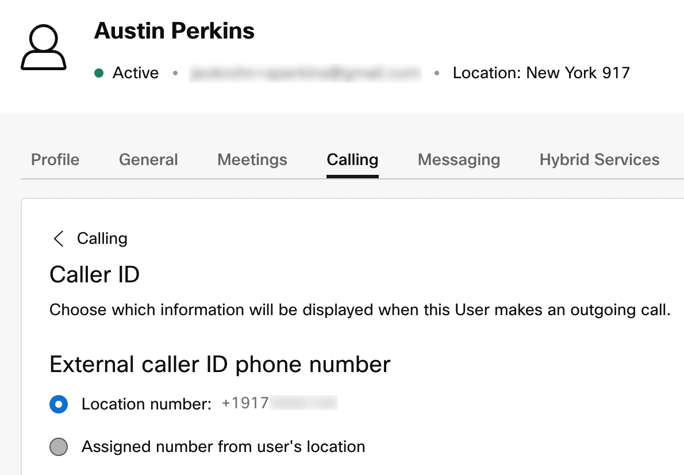
Webex Calling Multi-Tenant Caller Identity
Caller ID for Calls from Webex Calling to Trunks
If +E.164 is desired and the user has no TN then the caller ID is determined by the user’s caller ID setting
TN and/or extension configured? |  |  | “Caller ID Format for Calls from and to On-premises”
 |  |  | +E.164 | ESN
TN | Extension | PAI | From | From
Yes | Yes | TN, +E.164 | TN, +E.164 | Location prefix + extension
Yes | No | TN, +E.164 | TN, +E.164 | According to user caller ID configuration, +E.164
No | Yes | Location main number, +E.164 | According to user caller ID configuration, +E.164 | Location prefix + extension
No | No | No calls allowed without either TN or extension configured

Slide 45
Webex Calling Multi-Tenant Caller Identity
Caller ID for Calls from Webex Calling to Trunks
TN and/or extension configured? |  |  | “Caller ID Format for Calls from and to On-premises”
 |  |  | +E.164 | ESN
TN | Extension | PAI | From | From
Yes | Yes | TN, +E.164 | TN, +E.164 | Location prefix + extension
Yes | No | TN, +E.164 | TN, +E.164 | According to user caller ID configuration, +E.164
No | Yes | Location main number, +E.164 | According to user caller ID configuration, +E.164 | Location prefix + extension
No | No | No calls allowed without either TN or extension configured
If ESN is desired and the user has an extension then ESN (location prefix + extension) is used. W/o location prefix configured extension.

Slide 46
Webex Calling Multi-Tenant Caller Identity
Caller ID for Calls from Webex Calling to Trunks
TN and/or extension configured? |  |  | “Caller ID Format for Calls from and to On-premises”
 |  |  | +E.164 | ESN
TN | Extension | PAI | From | From
Yes | Yes | TN, +E.164 | TN, +E.164 | Location prefix + extension
Yes | No | TN, +E.164 | TN, +E.164 | According to user caller ID configuration, +E.164
No | Yes | Location main number, +E.164 | According to user caller ID configuration, +E.164 | Location prefix + extension
No | No | No calls allowed without either TN or extension configured
If ESN is desired and the user has no extension then user’s +E.164 caller id is used as fallback

Slide 47
Webex Calling Multi-Tenant Caller Identity
Caller ID for Calls from Webex Calling to Trunks
TN and/or extension configured? |  |  | “Caller ID Format for Calls from and to On-premises”
 |  |  | +E.164 | ESN
TN | Extension | PAI | From | From
Yes | Yes | TN, +E.164 | TN, +E.164 | Location prefix + extension
Yes | No | TN, +E.164 | TN, +E.164 | According to user caller ID configuration, +E.164
No | Yes | Location main number, +E.164 | According to user caller ID configuration, +E.164 | Location prefix + extension
No | No | No calls allowed without either TN or extension configured
We can have different caller ID formats in From: and PAI:. This can be useful when using premises PSTN and still requiring extension dialling between Webex Calling and premises users.

Slide 48
Interworking between Webex Calling and Unified CM On-Premise

Slide 49
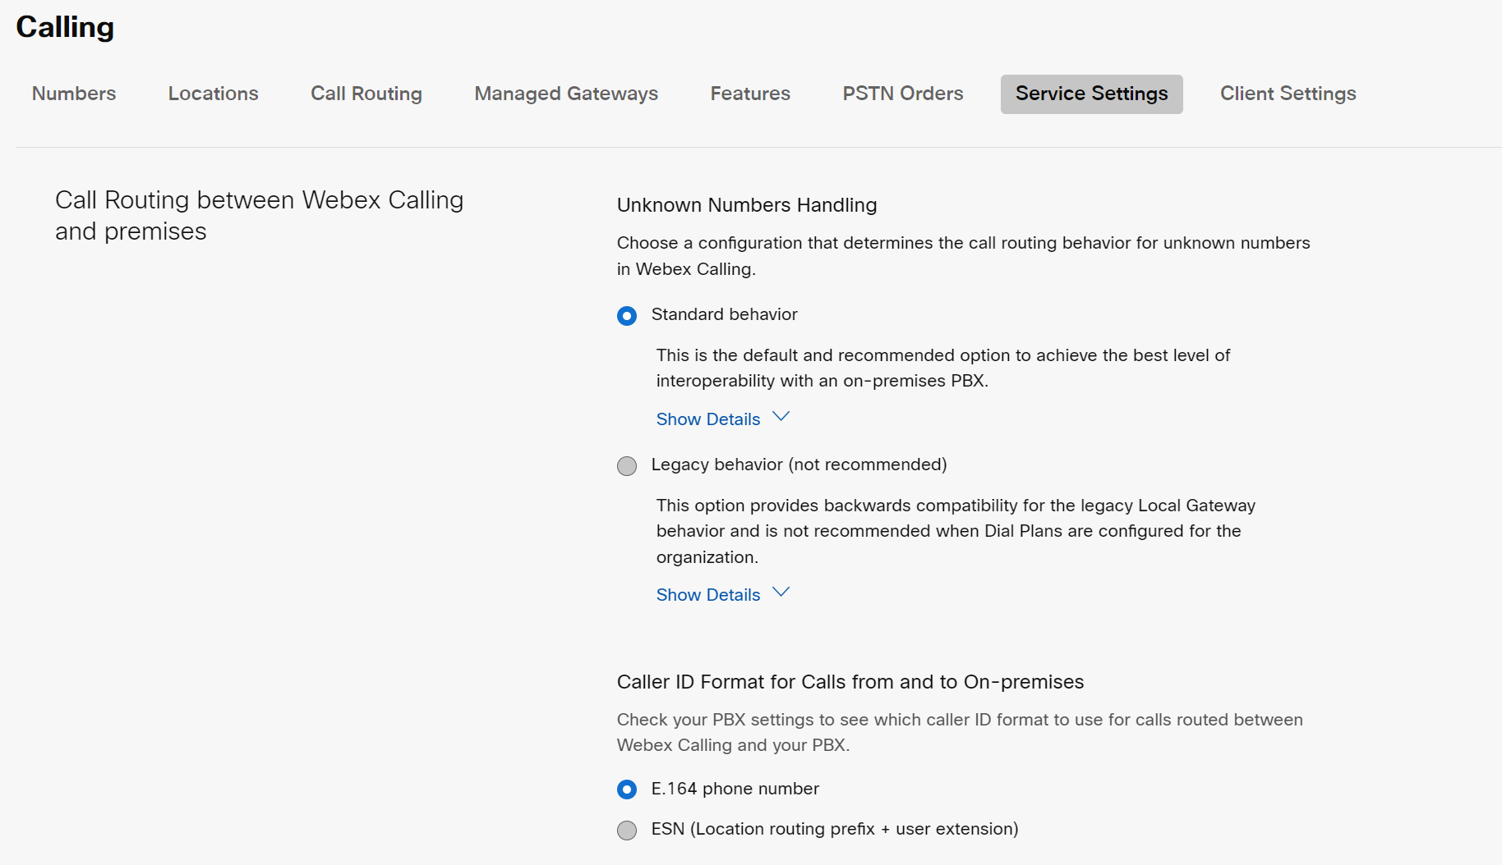
Interworking between Webex Calling and Unified CM On-Premise
Webex Calling service settings for premises call routing
Standard: Calls treated as premises or external based on caller id – requires dial plan
Legacy: unknown calls treated as premises
Choose caller ID format for calls from Webex Calling to PBX

Slide 50
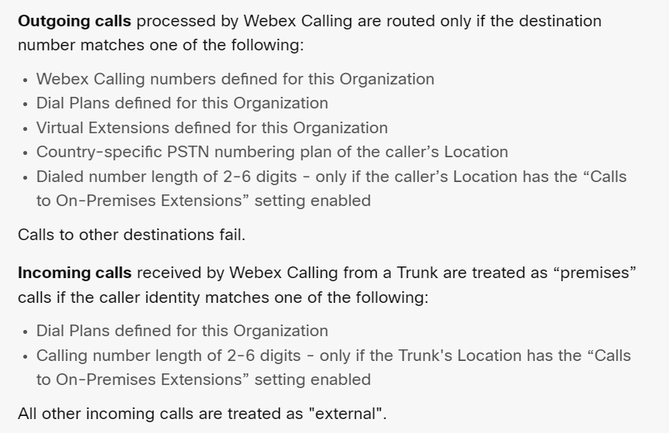
Interworking between Webex Calling and Unified CM On-Premise
Standard behavior for unknown number handling
This is the default and recommended option to achieve the best level of interoperability with an on-premises PBX
Outgoing calls:
Processes on defined pattern matching
Allows for unknown matching on extensions
Control Hub text doesn’t reflect order of operation
Incoming calls:
Caller ID matching is enforced to determine external or premise calls
Required match for specific call routing transit scenarios (e.g. Trunk to Trunk calls)
Provides support for internal versus external feature use (e.g. Executive Filter on internal vs. external)

Slide 51



Interworking between Webex Calling and Unified CM On-Premise
Call flows From WxC to UCM
WxC user dials +E.164* of UCM user
Cisco Calling Plan
WxC user dials ESN of UCM user
CCPP
WxC user dials a Non-E.164 PSTN number
PSTN
Internet
Enterprise A
Site 1
Site 2
Site 3
80011002 dialed
+13105551001 dialed
GW
411 dialed
UCM
LGW
2001
80022001
+12125552001
3001
80033001
+14085553001
80011001
+13105551001
80011002
Non-DID
* Webex Calling will normalize country national or international numbers into +E.164 during routing analysis

Slide 52
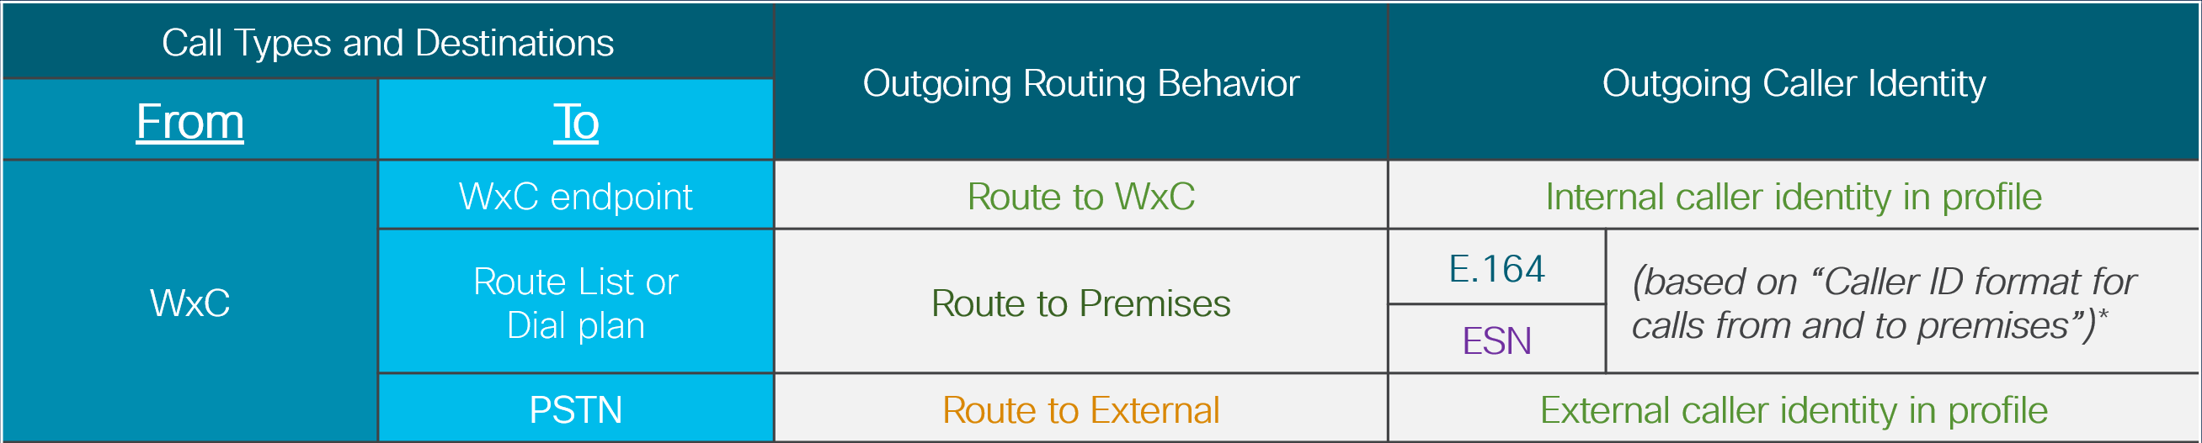
Interworking between Webex Calling and Unified CM On-Premise
WxC to UCM – Outbound routing check
How a call is matched during outbound routing can affect how the call is presented to UCM
Dial Plan match
Will be checked on initial route lookup or on a re-tried +E.164 lookup
Routes as Premise Call
Caller ID will be based on Service Settings value
NS lookup based on the country dial plan
Country is determined by the calling source’s location
Routes as PSTN External Call
Caller ID will be based on External Caller ID
Dial Plan
Yes
2
DP
Strict match
NS lookup
Based on national dial plan
2
PSTN

Slide 53
Interworking between Webex Calling and Unified CM On-Premise
WxC to UCM - Dial plan outgoing match +E.164 & ESN
Dial Plan is created with +E.164 numbers or pattern ranges residing on Unified CM
Dial Plans are global for an Enterprise and apply to all their users regardless of Location
→ Routing choice for given Dial Pattern is same for everybody
ESN used for ITN dial plans
Can use multiple LGWs for scale and redundancy
Avoidances:
Extensions – can cause issues in country dial plans for global deployments and unscalable for overlap ranges
TEHO – forces all locations dialing that pattern to egress through a single point, not supported by TAC
CA PBX Dial Plan
+1408525XXXX
CA-RG-1 Route Group
8408XXXX
+1310444XXXX
8310XXXX
#1
#2
us.foo.com
SJ Trunk A
LA Trunk A
SJ CUBE
LA CUBE

Slide 54
Interworking between Webex Calling and Unified CM On-Premise
WxC to UCM - Dial plan outgoing match +E.164 & ESN
Dial Plan is created with +E.164 numbers or pattern ranges residing on Unified CM
Dial Plans are global for an Enterprise and apply to all their users regardless of Location
→ Routing choice for given Dial Pattern is same for everybody
ESN used for ITN dial plans
Can use multiple LGWs for scale and redundancy
Avoidances:
Extensions – can cause issues in country dial plans for global deployments and unscalable for overlap ranges
TEHO – forces all locations dialing that pattern to egress through a single point, not supported by TAC
Extensions: extension routing to premises is established by using the unknown extension routing policy on a Webex Calling location
TEHO: Webex Calling dial plans are meant to establish routes to premises (not PSTN!) destinations. Calls from PSTN will be wrongly classified as premises calls.
CA PBX Dial Plan
+1408525XXXX
CA-RG-1 Route Group
8408XXXX
+1310444XXXX
8310XXXX
#1
#2
us.foo.com
SJ Trunk A
LA Trunk A
SJ CUBE
LA CUBE

Slide 55
Interworking between Webex Calling and Unified CM On-Premise
WxC to UCM - Numeric dial pattern syntax
numeric_pattern := ("+" 1*DIGIT [( "!" / 1*"X" )]) / (1*DIGIT [ 1*"X" ])
Where DIGIT := “0“ - “9“
Wildcards:
X : represents a single digit (0-9)
! : represents a sequence of one or more digits (0-9); only allowed with +E.164 prefixes
Examples:
+1408555XXXX | 11-digit +E.164 number starting with +14085555
+14085551234 | exact dial string +14085551234
+496100! | any dial string starting with +496100
84969XXX | 8-digit ESN starting with 84969
84969764 | exact 8-digit ESN 84969764

Slide 56
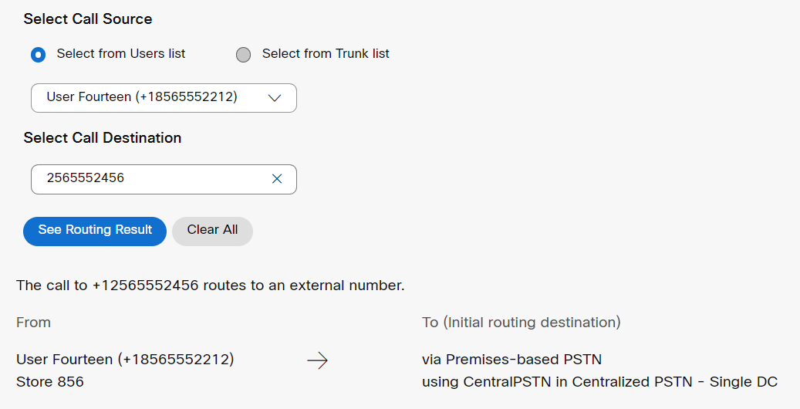
Interworking between Webex Calling and Unified CM On-Premise
WxC to UCM – National dial plan outgoing match
The outbound dial string is analyzed based on the national dial plan of the calling user
National dials plans will try to globalize to +E.164 for routing if possible (Toll-Free, National and International)
Non-E.164 patterns are not adjusted
US NANP 10-digit example
A 10-digit pattern will match and prepend the plus and the country code

Slide 57

Interworking between Webex Calling and Unified CM On-Premise
WxC to UCM – National dial plan outgoing match
The outbound dial string is analyzed based on the national dial plan of the calling user
National dials plans will try to globalize to +E.164 for routing if possible (Toll-Free, National and International)
Non-E.164 patterns are not adjusted
US NANP 10-digit example
A 10-digit pattern will match and prepend the plus and the country code
US NANP 7-digit example
A 7-digit pattern will match and prepend plus, country code and NPA
The source caller’s NPA is used to fill in the blanks!
Digits sent to LGW will be full +E164

Slide 58
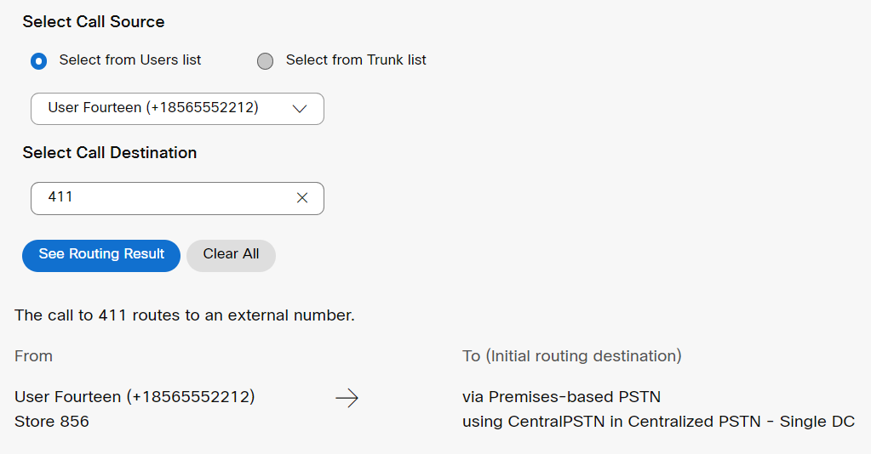
Interworking between Webex Calling and Unified CM On-Premise
WxC to UCM – National dial plan outgoing match
The outbound dial string is analyzed based on the national dial plan of the calling user
National dials plans will try to globalize to +E.164 for routing if possible (Toll-Free, National and International)
Non-E.164 patterns are not adjusted
US NANP 10-digit example
A 10-digit pattern will match and prepend the plus and the country code
US NANP 7-digit example
A 7-digit pattern will match and prepend plus, country code and NPA
The source caller’s NPA is used to fill in the blanks!
Digits sent to LGW will be full +E164
US special numbers example
A 3-digit number will be delivered as dialed
Non-E164 will require pattern routing on UCM

Slide 59
Interworking between Webex Calling and Unified CM On-Premise
WxC to UCM – Incoming to UCM +E.164 & ESN Matches
Unified CM needs to support ESN and +E.164 as called address for calls from WxC
+E.164
trivial, match on +E.164 DN or PSTN RP
ESN
match on ESN dialing normalization pattern in OnNetRemote partition
Called party gets normalized to +E.164
calling search space inheritance on TP: same calling search space used again for post-translation lookup
Match on +E.164 DN
Non-Preferred Architecture designs, apply appropriate translations before DN lookup!
Trunk
CSSs
Partitions
Trunk Inbound CSS
DN
Webex Calling LGW
All IP Phone DNs (+E.164)
OnNetRemote
81012.XXX, Pre-Dot, Prefix +12125550
PSTN
\+1XXXXXXXXXX \+!
LRG / RL / GW

Slide 60
Interworking between Webex Calling and Unified CM On-Premise
WxC to UCM – Incoming to UCM PSTN specific matches
PSTN calls from WxC use the PSTN native national number format for Non-E.164
Non-E.164 numbers
RP must include special numbers
Redundancy is handled by UCM Route lists
This enforces a country boundary on the Trunk between UCM and WxC due to Non-E.164 potential overlap
Solution – Duplicate end-to-end trunk configuration to route for multi-country Non-E.164
This can be achieved with a single CUBE in centralized trunking scenarios using multiple tenants on the CUBE.
Trunk
CSSs
Partitions
US Trunk
Inbound CSS
DN
Webex Calling LGW
All IP Phone DNs (+E.164)
OnNetRemote
81012.XXX, Pre-Dot, Prefix +12125550
US PSTN
\+1XXXXXXXXXX \+!
411
LRG / RL / GW

Slide 61
Interworking between Webex Calling and Unified CM On-Premise
Call flows From UCM to WxC
UCM user dials +E.164 of WxC user
Cisco Calling Plan
UCM user dials ESN of WxC user
CCPP
PSTN caller dials +E.164 of WxC User
+14085553001 dialed
PSTN
Internet
Enterprise A
Site 1
Site 2
Site 3
GW
UCM
LGW
2001
80022001
+12125552001
3001
80033001
+14085553001
80011001
+13105551001
80011002
Non-DID
+12125552001 dialed
80011002 dialed

Slide 62
Interworking between Webex Calling and Unified CM On-Premise
UCM to WxC - +E.164 Outbound Route Patterns
With a single Egress LGW selection not site specific → no LRG based LGW selection required*
Multiple LGWs in multiple locations: RL and LRG
Can can use multiple LGWs for scale and redundancy
Webex Calling destinations provisioned as +E.164 route patterns
CSSs
Partitions
Route Lists
Route Groups
NYCInternational
DN
All IP Phone DNs (+E.164)
NYCtoE164
1XX, Prefix +12125550
9.[2-9]XXXXXX, Pre-Dot, Prefix +1212
Remaining Partitions
WebexCalling
+E.164 RPs for all Webex Calling destinations
Webex Calling RL
Webex Calling RG
*For extension dialling w/ non-unique extensions site specific trunks are required so that Webex Calling can establish proper dialling context. LRG can be used for site specific egress trunk selection

Slide 63
Interworking between Webex Calling and Unified CM On-Premise
UCM to WxC – ESN Outbound Route Patterns
Any dialing habit can be transformed to +E.164 using dialing normalization translations
Dialing normalization for Webex Calling ESN ranges to +E.164 in same partition as Webex Calling route patterns
CSSs
Partitions
Route Lists
Route Groups
NYCInternational
DN
All IP Phone DNs (+E.164)
DN
NYCtoE164
1XX, Prefix +12125550
9.[2-9]XXXXXX, Pre-Dot, Prefix +1212
OnNetRemote
81012.XXX, Pre-Dot, Prefix +12125550
WebexCalling
Webex Calling RL
Webex Calling RG
81101.1XX, Pre-Dot, Prefix +14085550
\+140855501XX

Slide 64
Interworking between Webex Calling and Unified CM On-Premise
UCM to WxC – ESN Outbound Route Patterns
Any dialing habit can be transformed to +E.164 using dialing normalization translations
Dialing normalization for Webex Calling ESN ranges to +E.164 in same partition as Webex Calling route patterns
Better solution: use ESN route patterns for Webex Calling ESN ranges → also works with extension only Webex Calling destinations
CSSs
Partitions
Route Lists
Route Groups
NYCInternational
DN
All IP Phone DNs (+E.164)
DN
NYCtoE164
1XX, Prefix +12125550
9.[2-9]XXXXXX, Pre-Dot, Prefix +1212
OnNetRemote
81012.XXX, Pre-Dot, Prefix +12125550
WebexCalling
Webex Calling RL
Webex Calling RG
81101.1XX
\+140855501XX

Slide 65
Interworking between Webex Calling and Unified CM On-Premise
UCM to WxC – PSTN Outbound Route Patterns
PSTN Dial Plan can utilize the same Route Patterns for +E.164 dialing as UCM users.
If PSTN gateway is sending only a subset of digits to UCM, the number will need to be converted to +E.164 before sending to WxC.
Multiple ways to do on UCM:
Called Party Transformation Patterns (preferred)
Translation Pattern (shown)
Route Patterns
Trunk
CSSs
Partitions
Trunk Inbound CSS
DN
PSTN Gateway
All IP Phone DNs (+E.164)
WebexCalling
Webex Calling RL
Webex Calling RG
+E.164 RPs for all Webex Calling destinations
Gateway Translations
1XXX, Prefix +1408555

Slide 66
Interworking between Webex Calling and Unified CM On-Premise
UCM to WxC - Caller ID for Calls
Best practice on Unified CM: “globalize on ingress, localize on egress”*
Calling party transformation
Side-effect of routing: calling party transform on RP/TP
Explicit: calling party transformation patterns, calling party transformation CSS on SIP trunk
If global DN format is used on Unified CM then no Webex Calling specific upstream calling party transformation is required
Both, +E.164 or ESN are acceptable caller ID formats
For other formats caller ID needs to be transformed to +E.164 (preferred) or ESN (fallback for non-DID users).
PSTN format can be delivered in National or +E.164 (preferred) format.
*see “Preferred Architecture for Cisco Collaboration 14 Enterprise On-Premises Deployments, CVD”

Slide 67
Interworking between Webex Calling and Unified CM On-Premise
UCM to WxC - Enterprise Number Formats for Calls
Different Number formats commonly used in calling deployments
Calling party is key for proper call classfication (prem vs. PSTN)
Dial plan match for number formats with global significance (ESN, +E.164)
Number length and unknown extension policy enabled for extensions
Prem classification important for: extension/ESN dialling, trunk-to-trunk calls, calling features with differentiated treatment for prem vs. PSTN calls
 | Example | Calling Party Requirements | Called Party
Extension | 1501 | 2-6 digits, unknown extension policy enabled on trunk‘s location | Call routed in context of pilot user of trunk’s location
ESN | 8 496 9764 | Dial plan match | Unique address
+E.164 | +1 408 555 0123 | Dial plan match | Unique address

Slide 68


Interworking between Webex Calling and Unified CM On-Premise
UCM to WxC – Inbound E.164 & ESN matching
Inbound to Webex Calling, the originating trunk is identified by the otg tag inserted into the “From” header by the Local Gateway
Call classification checks the unscreened caller ID and is matched against dial plan patterns
If a match is found, then the call is classified as premises call
If no match is found, then the call is classified as external call
Before routing to the called destination, call classification determines which destinations can be reached via transit routing:
Premise calls - allowed transit routing is WxC Org number or Trunks
External calls - will restrict the call to WxC Org numbers only
CCPP or Cisco PSTN are not supported via transit routing
Calling Party Number
+14085251000
CA PBX Dial Plan
+1408525XXXX
8408XXXX
SJ CUBE
+1310444XXXX
otg=sj-lgw
8310XXXX
Premise Call
us.foo.com
SJ Trunk A
Transit Routing
WxC Org Numbers
Trunks
CCPP
Cisco PSTN

Slide 69




Interworking between Webex Calling and Unified CM On-Premise
UCM to WxC - PSTN Number Format Considerations
Caller ID from PSTN | Called Party number Format | Call routing with Standard Behavior
+E.164 or National | +E.164
+E.164 or National | E.164 (NANP 11D)
+E.164 or National | National (NANP 10D)
+E.164 or National | Extension | (extension dialling only possible for prem calls)
Cisco Calling Plan
Calling
CCPP
PSTN
Internet
Site 1
Site 2
Local GW
Note: Caller ID sent to Webex Calling must be in the format of a supported dialling habit. Keep in mind that it might end up in a missed calls directory…

Slide 70
Special Case: Flat Extension Dialing

Slide 71
Flat Extension Dialling
Scenario
Non-overlapping extension ranges in all locations
Locations on Unified CM and Webex Calling
Unified CM DNs are extensions (diversion from best practice in the PA)
Local Gateway to interconnect Unified CM and Webex Calling
Calling
Internet
Site 1
Site 2
Site 3
1501
Local GW
3105
2304

Slide 72
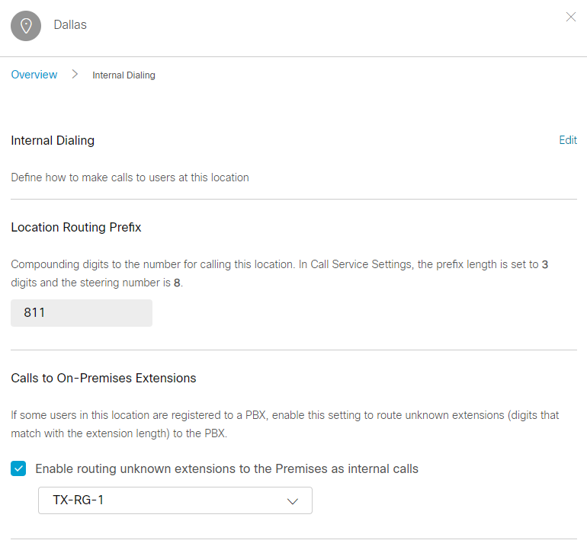
Flat Extension Dialling
Recommend approach for calls to on-premises extensions
Alllows preservation of dialing habits in “mixed” cloud/premises sites:
Users can continue to use abbreviated dialing (e.g., 4 digits) even if the site has partially migrated to Webex Calling
When this per-location setting is enabled:
Calls made by users at this location to an unknown “extension” (i.e., same digit length as internal extensions) are routed to the selected Route Group/Trunk as “Premises” calls
Calls received by Webex Calling via trunks at this location from an unknown extension (matching extension length) are handled as “Premises” calls

Slide 73
Flat Extension Dialling
Unknown extension to the Premise routing
Enterprise
Note: The downstream LGW and UCM must support an extension dial plan and may require a dedicated trunk for overlapping extension deployments
In this Location calls to unknown extensions are blocked
Location Dallas
Unknown Ext.
Trunk SJ 1
SJ LGW1
Location SJ
Route Group 1
✓
Trunk SJ 2
SJ LGW2
Unknown Ext.
In these Locations calls to unknown extensions are routed to a Route Group or Trunk
Location LA
✓
Trunk LA
LA LGW
Unknown Ext.
Location UK
✓
Trunk UK
UK LGW
Unknown Ext.

Slide 74
Flat Extension Dialling
Webex Calling to Webex Calling
Webex Calling user dials extension of user in other location
Webex Calling allows inter-location extension dialling
Not a problem with non-overlapping extension ranges
Calling
Internet
Site 1
Site 2
Site 3
Local GW
“2304”
1501
3105
2304

Slide 75
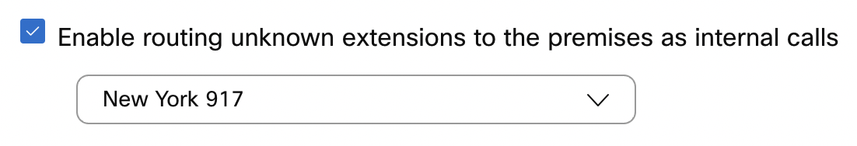
Flat Extension Dialling
Webex Calling to Unified CM
Webex Calling user dials extension of Unified CM user
Unknown extension policy is enabled for calling user’s location
Call is sent to selected destination
Unified CM dial plan routes based on extension match on DN
Calling
Internet
Site 1
Site 2
Site 3
Local GW
“1501”
1501
3105
2304

Slide 76
Flat Extension Dialling
Webex Calling to Unified CM (UCM Dial Plan)
Unified CM uses a flat extension dial plan
DNs are extensions
Note: not in line with best practices documented in the PA docs
Trivial setup: trunk calling search space only needs access to DN partition
Trunk
CSSs
Partitions
Trunk Inbound CSS
DN
Webex Calling LGW
All IP Phone DNs (extensions )

Slide 77
Flat Extension Dialling
Unified CM to Webex Calling
Unified CM user dials extension of Webex Calling user
Unified CM routes to Local Gateway via RP (e.g. „[23]XXX“)
Caller id is Unified CM user‘s extension
Unknown extension policy is enabled for trunk’s location → call classified as “prem”, extension dialling allowed
Call routed to Webex Calling user
Calling
Internet
Site 1
Site 2
Site 3
1501
Local GW
“3105”
3105
2304

Slide 78
Flat Extension Dialling
Unified CM to Webex Calling (Unified CM Dial Plan)
Unified CM uses a flat extension dial plan
DNs are extensions
Note: not in line with best practices documented in the PA docs
We need a route pattern to match the Webex Calling extension ranges and send them to Webex Calling
To enable callback from missed calls directory also RPs needed for
ESN (if site prefixes are configured on Webex Calling)
+E.164 (if caller ID format on Webex Calling is set to +E.164)
CSSs
Partitions
Route Lists
Route Groups
NYCInternational
DN
All IP Phone DNs (extensions)
NYCtoE164
9212555.1XXX, strip Pre-Dot
WebexCalling
Webex Calling RL
Webex Calling RG
Remaining Partitions
[23]XXX 80112XXX 80123XXX +19295551XXX
+18105553XXX

Slide 79
Flat Extension Dialling
Unified CM to Webex Calling (Unified CM Dial Plan)
Unified CM uses a flat extension dial plan
DNs are extensions
Note: not in line with best practices documented in the PA docs
We need a route pattern to match the Webex Calling extension ranges and send them to Webex Calling
To enable callback from missed calls directory also RPs needed for
ESN (if site prefixes are configured on Webex Calling)
+E.164 (if caller ID format on Webex Calling is set to +E.164)
CSSs
Partitions
Route Lists
Route Groups
NYCInternational
DN
All IP Phone DNs (extensions)
NYCtoE164
9212555.1XXX, strip Pre-Dot
WebexCalling
Webex Calling RL
Webex Calling RG
Remaining Partitions
[23]XXX 80112XXX 80123XXX +19295551XXX
+18105553XXX

Slide 80
Interworking between Webex Calling and Unified CM On-Premise
Unified CM via LGW to Webex Calling (Extension)
Inbound to Webex Calling, the originating trunk is identified by the otg tag inserted into the “From” header by the Local Gateway
Call classification based on location level setting for “Calls to On-Premises Extensions” > “Enable routing unknown extensions to the Premises as internal calls”
Enabled → premises call
Disabled and no dial plan match → external call
Before routing to the called destination, call classification determines which destinations can be reached via transit routing:
Premises calls - allowed transit routing is WxC org number
External calls – are rejected
Calling Party Number
1501
Location SJ
✓
SJ CUBE
Unknown Ext.
otg=sj-lgw
Premise Call
SJ Trunk A
Transit Routing
WxC Org Numbers
Trunks
CCPP
Cisco PSTN

Slide 81
Interworking between Webex Calling and Dedicated Instance

Slide 82
Interworking between Webex Calling and Dedicated Instance
Concepts
Connection to dedicated instance identical to integration with Unified CM
SIP trunk between Webex Calling and DI via Local Gateway
Dial plan configuration on both sides: DI and Webex Calling
Different for dedicated instance
pre-provisioned Local Gateway, Webex Calling trunk, Unified CM trunk
Cloud PSTN for DI users (route lists)
+12125552XXX
81212XXX
…
+14085551XXX
81401XXX
…
Calling

Slide 83
Interworking between Webex Calling and Dedicated Instance
Pre-Configured
Trunk and route group on Webex Calling multi-tenant
Location for that trunk (customer needs to set main number)
Local Gateway instance automatically provisioned (cloud managed)
SIP trunk on dedicated instance
Call routing (dial plans) still needed …
Dedicated instance
Webex Calling
Calling
Pre-provisioned

Slide 84
Interworking between Webex Calling and Dedicated Instance
Interworking: Unified CM On-Premises, Webex Calling and Dedicated Instance
Interworking w/ on-premises Unified CM required during transition period
Connect Unified CM to dedicated instance or multi-tenant?
Considerations
Dedicated instance not meant to act as tandem (session manager)
Where does the majority of the users live?
Capabilities: SIP/SIMPLE presence, CCNR/CCBS, …
PSTN: (ab)use CCPP for prem users using DI as transit? Use prem PSTN for both, Webex Calling and Di?
Multi-tenant can route between users on dedicated instance and on-premises Unified CM using Webex Calling dial plans
Calling

Slide 85
Interworking between Webex Calling and Dedicated Instance
Transit Routing from Unified CM to DI
DI and Unified CM are both “spokes” in this topology
“Default” routing to Webex Calling still not an option:
PSTN on spokes.
Spokes need deterministic routes to Webex Calling (and transit)
Design option: ILS/GDPR between Unified CM and DI combined with imported catalog for all Webex Calling destinations.
Three route strings: DI, Unified CM, Webex Calling
SIP route patterns on Unified CM and DI pointing to Webex Calling
Webex Calling still needs a dial plan for the Unified CM destinations; routing to DI via route list
Imported catalogs and dial plans both can be provisioned using CSVs (different format, but can be created from same data source)
GDPR mainly simplifies configuration of DI and UCM (transit routes learned automatically, same imported catalog for Webex Calling destinations on DI and Unified CM)
Calling
+12125552XXX
81212XXX
…
ILS/GDPR
+14085551XXX
81401XXX
…
PSTN

Slide 86
Interworking between Webex Calling and Dedicated Instance
GDPR Imported Catalog - Example
SIP route pattern for catalog’s route string needs to be provisioned in the WebexCalling partition
BAT File format (example):
PatternType,PSTNFailover,Pattern
pattern,2:+0,+1408555012X@example.com
pattern,2:+0,+1212555013X@example.com
pattern,0:+0,811011XX@example.com
GDPR PSTN failover needs to be suppressed (illegal numbers) if PSTN access for Webex Calling destinations is via UCM; else: loops!
Forcing illegal number for GDPR PSTN failover (strip/prefix). Make sure that dial plan blocks \+0! or use prefix not covered by PSTN route patterns*
+E.164 destination in Webex Calling
Abbreviated inter-site dialing to Webex Calling
*If Webex Calling is not using premises PSTN then GDPR PSTN failover actually is an alternative to using the Local Gateway trunk)

Slide 87
Interworking between Webex Calling and Dedicated Instance
GDPR Imported Catalog Considerations
Allows to share Webex Calling destinations between clusters: for example for SME deployments with centralized LGW
Calls coming into UCM from Webex Calling need access to destinations learned from other clusters via ILS/GDPR (access to remote on-net sites)
Imported +E.164 and ESN patterns end up in the same partition as destinations learned from other clusters (for example OnNetRemote)
Breaking the loop: SIP route pattern for catalog’s route string is in partition the trunk from Webex Calling does not have access to

Slide 88
Cloud Connected PSTN for Dedicated Instance

Slide 89
Cloud Connected PSTN for Dedicated Instance
Why Route Lists
Without route lists: „Premises“ users calling into Webex Calling via a trunk
Call is treated as premises call based on caller ID match on dial plan pattern
Only allowed: trunk-to-trunk and trunk-to-hosted (destination on Webex Calling)
Not allowed/blocked: trunk-to-PSTN
Purpose of route list
Define set of users (identified by +E.164 TN) allowed for PSTN access
CCPP to DI: allow calls from PSTN to DI user via route group (trunk)
DI to CCPP: allow calls from route group (trunk) to PSTN

Slide 90
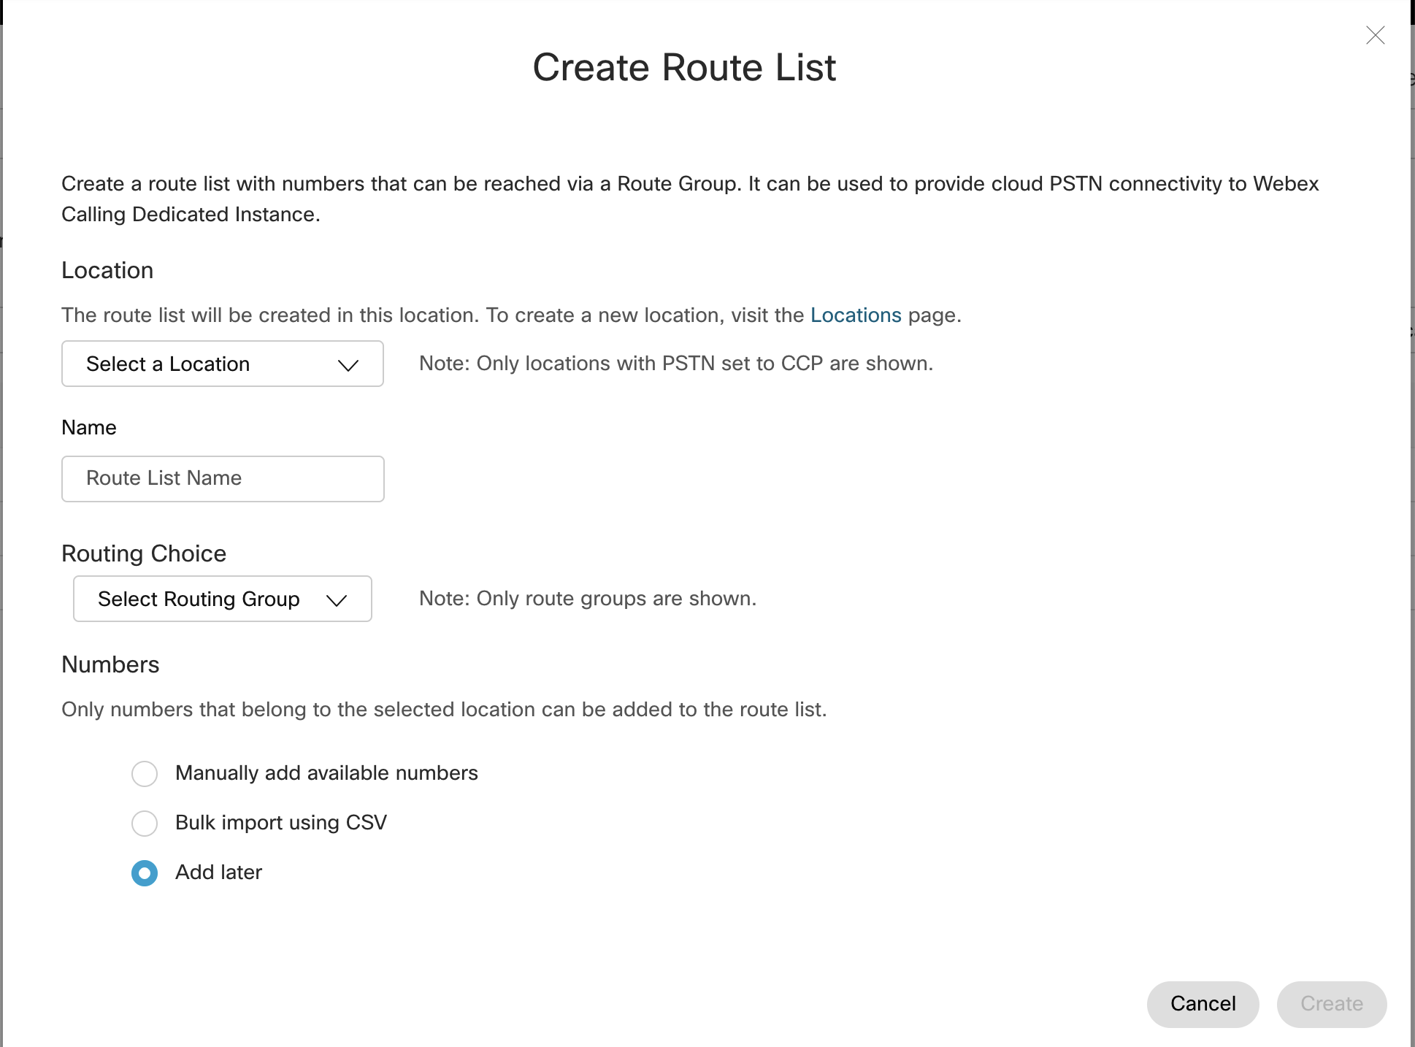
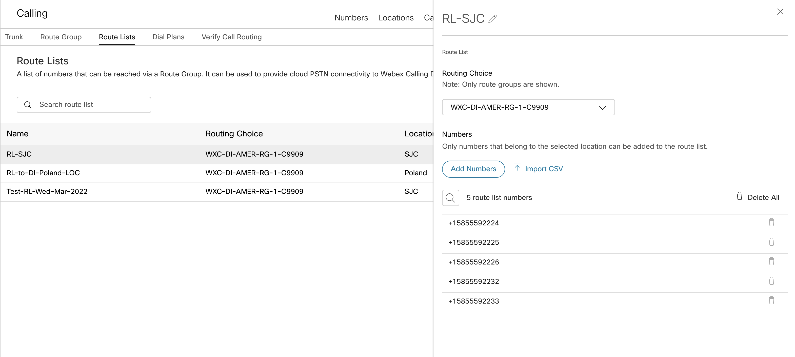
Cloud Connected PSTN for Dedicated Instance
Webex Calling call routing overview
Route Lists in Webex Calling are lists of numbers reachable through a Route Group.
Each Route List is exclusively assigned to a Location that supplies up to 40,000 unassigned numbers from the hosted pool.
Route List
Adding PSTN numbers to Route List*
* manual, CSV, API … which is exposed to all customers (not only DI customers)

Slide 91
Cloud Connected PSTN for Dedicated Instance
Route lists and other call routing elements
Location SJ
This is how Webex Calling and PSTN users reach the +E.164 numbers (users) configured on DI
Route list with
+E.164’s for DI in SJ Location
DI SJ Route List
Dedicated Instance
+14085551001
DI Trunk 1
+14085551003
…
DI Route Group
PSTN connection
This is how users at this location reach the PSTN
DI Trunk 2
Location DFW
Route list with
+E.164’s for DI in DFW Location
DI DFW Route List
+19725558001
+19725558003
CCPP 1
…
PSTN connection
This is where the
trunks “live” (dial plan context for inbound calls)
Location DI
DI Trunk 1
DI Trunk 2

Slide 92
Reminder
Cloud Connected PSTN for Dedicated Instance
On-premises users behind trunks cannot use Cloud PSTN, DI users can
Screening and Routing
 | WxC User | Trunk (RL match) | Trunk (DP match) | Cloud PSTN (CCPP or Cisco)
WxC User
Trunk (RL match on CLID)
Trunk (prem user call)*
Trunk (prem PSTN call)*
Cloud PSTN (CCPP or Cisco)
To
To
From
*prem user vs PSTN: caller ID match on DP pattern, or extension

Slide 93
Cloud Connected PSTN for Dedicated Instance
Call Flow: PSTN to DI user
Incoming call from PSTN
Webex Calling routing lookup
Destination found in route list
Call forwarded to route list’s routing choice: route group (trunk) to DI
DI routes call to DI user
Route List
Route List
+14085550123
+14085550124
+14085550135
…
+14085550123
+14085550124
+14085550135
…
Calling
CCPP
+14085550124
+14085550124

Slide 94
Cloud Connected PSTN for Dedicated Instance
Call Flow: DI user to PSTN user
Unified CM route lookup
Send to PSTN (SIP trunk to Webex Calling)
Webex Calling lookup to classify call
Caller id found in route list → cloud PSTN access allowed
Webex Calling route lookup
Routing context: trunk’s location
Call sent to trunk location’s PSTN choice
Route List
Route List
+14085550123
+14085550124
+14085550135
…
+14085550123
+14085550124
+14085550135
…
Calling
CCPP
+14085550124

Slide 95
Q&A

Slide 97
Additional Slides

Slide 98
Webex Calling Multi-Tenant Dial Plan Foundations
Understanding location codes
What if extension ranges of sites overlap?
No extension dialing between sites
Alice can call Bob and Charlie using extension dialing
Alice cannot call Dave using extension dialing
What if Charlie dials 4002?
Widgets, Inc.
LA
NY
Montreal
Alice
Bob
Charlie
Dave
4001
+13105554001
4002
+13105554002
+12125556001
4002

Slide 99
Webex Calling Multi-Tenant Dial Plan Foundations
Conflicts
To avoid timeouts, conflicts need to be avoided between:
First digit of extensions
Internal steering digit
Outbound dial digit
Example: steering digit 8, 4D extensions, 4D location code
What if Alice lifts the handset and starts to dials 8, 2, 0, 2? Bob, Charlie?
Widgets, Inc.
Location | Location Code
LA | 8201
NY | 8202
Montreal | 8251
LA
NY
Montreal
Alice
Bob
Charlie
Dave
8001
82018001
+13105558001
8202
82018202
+13105558202
6001
82026001
+12125556001
4001
82514001
+15145554001

Slide 100
Webex Calling Multi-Tenant Dial Plan Foundations
Benefits of trunks, route groups and dial plans
Load balancing and failover across trunks to premises (scale, redundancy)
Communication between Cloud Connected PSTN users and premises users
Ability to route calls to different premises PBX’s based on:
E.164’s/DID’s
ESN’s (e.g., 8+site code+extension)
SIP URI’s (Webex Calling to PBX only)
“Tandem” functionality to route calls between premises PBX’s
Broader range of migration and co-existence scenarios with premises PBX’s, including “mixed” sites with premises users and Webex Calling users
Better visibility of call routing decisions

Slide 101
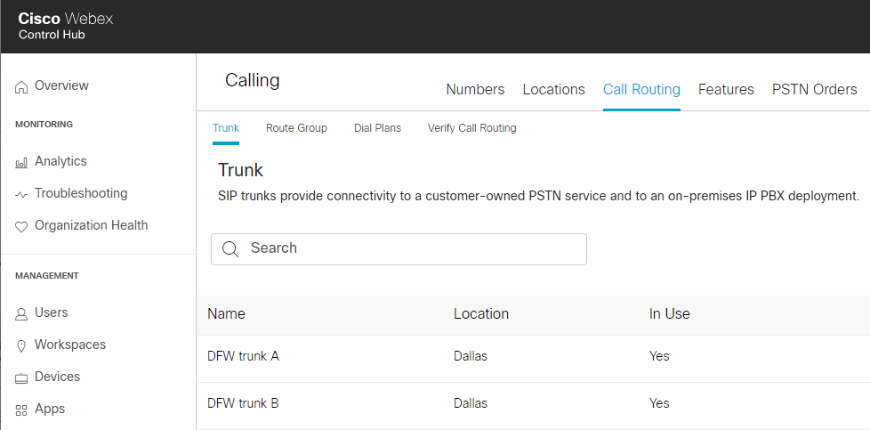




Webex Calling Multi-Tenant Dial Plan Foundations
Trunks connecting to on-premises devices
DFW Trunk A
Internet
PSTN
Represents a single SIP Trunk to an on-premises device (currently, only CUBE is supported)
Must be assigned to a Location
Can be included in one or more Route Groups
Dallas
Local Gateway
On-prem PBX
Webex endpoints

Slide 102
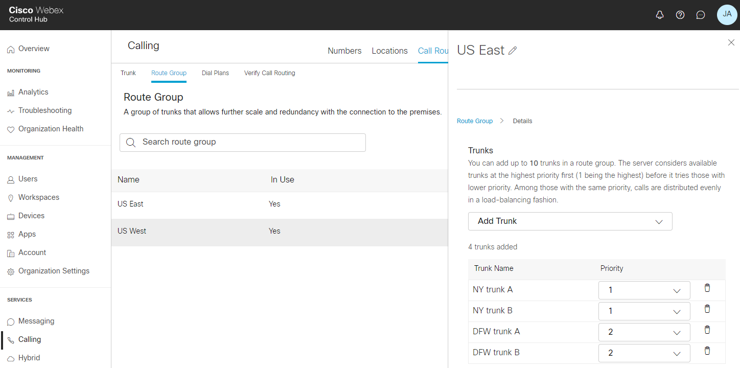
Webex Calling Multi-Tenant Dial Plan Foundations
Route groups - Scale and redundancy for trunks
Calls distributed randomly among Trunks with same priority
If a Trunk with lower priority order (1) is not available, system attempts to route call to a Trunk with a higher priority order (2)
Random pick
1
NY Trunk A
ny-LGW-A
Logical grouping of Trunks (max. 10) for scale and redundancy of connections to the premises
Does not “live” in a Location
US East (Route Group)
1
NY Trunk B
ny-LGW-B
2
DFW Trunk A
dfw-LGW-A
Random
pick
2
DFW Trunk B
dfw-LGW-B

Slide 103
Webex Calling Multi-Tenant Dial Plan Foundations
Route groups - Trunks in multiple route groups
NY Trunk A
ny-LGW-A
NY (Route Group)
Same trunks can be member of different Route Groups
Example:
Same set of trunks used by different Route Groups and have different prioity in each Route Group
Route Group NY prefers NY trunks and uses DFW as backup/overflow
Route Group DFW pefers DFW trunks ans uses NY as backup/overflow
NY Trunk B
ny-LGW-B
DFW (Route Group)
DFW Trunk A
dfw-LGW-A
DFW Trunk B
dfw-LGW-B

Slide 104
Webex Calling Multi-Tenant Dial Plan Foundations
Trunk selection, route advance
Start with group of trunks that have lowest priority value
Randomly pick one trunk from that group and try that trunk
On failure randomly pick a different trunk with same priority
SIP causes 401, 407, 480, 606 (if there has been no prior 18x response)
All other 4xx except 403, 404, 410, 413, 484, 486
All 5xx
SIP timeout (12 seconds)
If all trunks with this priority failed advance to next priority and repeat

Slide 105
Webex Calling Multi-Tenant Dial Plan Foundations
Dial Plans
Dial plans allow you to route calls to on-premises destinations by use of trunks or route groups. They are configured globally for an enterprise and apply to all users, regardless of location.
A dial plan also specifies the routing choice (trunk or route group) for calls that match any of its dial patterns. Specific dial patterns can be defined as part of your dial plan.
A dial pattern represents on-premises extensions:
ESN/on-net numbers
+E.164 patterns
SIP URI domains

Slide 106
Webex Calling Multi-Tenant Dial Plan Foundations
Dial Plan - SIP URI dial pattern syntax
Only domains (right-hand side of SIP URI after @) are matched
Either:
Fully qualified domain
Domain with a leading “*.” indicating all sub-domains of given domain
Examples:
Prefix | Meaning | Examples
example.com | only URIs with host portion “example.com” | alice@example.com
us.example.com | only URIs with host portion “us.example.com” | alice@us.example.com
*.example.com | URIs with host portion being sub-domain of “example.com” | alice@eu.example.com alice@sales.us.example.com Note: alice@example.com is not matched!

Slide 107
Webex Calling Multi-Tenant Dial Plan Foundations
Dial Plans
Enterprise
CA PBX Dial Plan
+1408525XXXX
CA-RG-1 Route Group
#1
SJ Trunk A
SJ CUBE
8408XXXX
+1310444XXXX
#2
8310XXXX
us.foo.com
UK PBX Dial Plan
LA Trunk A
LA CUBE
+442022!
8442XXXX
uk.foo.com
Location SJ
UK Trunk A
UK CUBE
Trunk SJ
Location LA
Dial Plans are defined globally for an Enterprise and apply to all their users regardless of Location
→ Routing choice for given Dial Pattern is same for everybody
Trunk LA
Location UK
Trunk UK

Slide 108




Webex Calling Multi-Tenant Dial Plan Foundations
Load balancing and failover
Load balancing and failover across trunks to premises (scale, redundancy)
Cisco Calling Plan
CCPP
Local Gateway Trunk
PSTN
Internet
Site 3
Local GW

Slide 109
Webex Calling Multitenant Dial Plan Foundations
Combine Cloud PSTN with premises trunks
Load balancing and failover across trunks to premises (scale, redundancy)
Communication between Cloud Connected PSTN users and premises users
Cisco Calling Plan
CCPP
Local Gateway Trunk
+12125552XXX
81212XXX
…
Internet
PSTN
Site 3
Local GW

Slide 110
Webex Calling Multi-Tenant Dial Plan Foundations
On-premises PBX routing
Local Gateway Trunk
Ability to route calls to different premises PBX’s
Cisco Calling Plan
CCPP
Local Gateway Trunk
+14085551XXX
81401XXX
…
+12125552XXX
81212XXX
…
Internet
PSTN
Site 3
Local GW
Local GW

Slide 111
Webex Calling Multi-Tenant Dial Plan Foundations
On-premises PBX routing
Local Gateway Trunk
Ability to route calls to different premises PBX’s
“Tandem” functionality to route calls between premises PBX’s
Cisco Calling Plan
CCPP
Local Gateway Trunk
+14085551XXX
81401XXX
…
Internet
+12125552XXX
81212XXX
…
PSTN
Site 3
Local GW
Local GW

Slide 112


Webex Calling Multi-Tenant Dial Plan Foundations
Mixed/split sites
Some users are on Webex Calling and others in the same location are on Unified CM
Users want to be able to use abbreviated intra-site dialling within a site (across call controls)
Example: Bob want to be able to Dial 4002 to reach Alice
Cisco Calling Plan
CCPP
Internet
PSTN
NY
Dallas
Alice 4002
Bob 4001
Dallas LGW

Slide 113
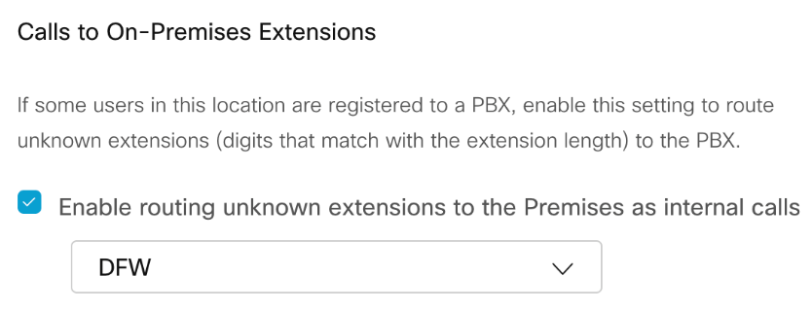
Webex Calling Multi-Tenant Dial Plan Foundations
Mixed/split sites
Some users are on Webex Calling and others in the same location are on Unified CM
Users want to be able to use abbreviated intra-site dialling within a site (across call controls)
Example: Bob want to be able to Dial 4002 to reach Alice
Cisco Calling Plan
CCPP
Internet
PSTN
NY
Dallas
Alice 4002
Bob 4001
Dallas LGW

Slide 114
Webex Calling Multi-Tenant Dial Plan Foundations
Mixed/split sites
“4002” is not a Webex Calling number and no match in dial plan .. but it “looks” like an an extension (2-6 digits) → route it!
Some users are on Webex Calling and others in the same location are on Unified CM
Users want to be able to use abbreviated intra-site dialling within a site (across call controls)
Example: Bob want to be able to Dial 4002 to reach Alice
Cisco Calling Plan
CCPP
Internet
PSTN
NY
Dallas
Alice 4002
Bob 4001
Dallas LGW
Signaling path only; media path with ICE is different

Slide 115
Webex Calling Multi-Tenant Dial Plan Foundations
Call between PBX users
Call classified as “premises” inbound into Webex Calling based on caller id match on DP pattern
Sent to trunk/RG based on DP match
Cisco Calling Plan
CCPP
PSTN
Internet
Enterprise A
Site 1
Site 1
Site 3
Local GW
Local GW

Slide 116
Webex Calling Multi-Tenant Dial Plan Foundations
PBX user or PSTN to Webex Calling user
Sent to user based on match on DID, extension or ESN
Cisco Calling Plan
CCPP
PSTN
Internet
Enterprise A
Site 1
Site 1
Site 3
Local GW
Local GW

Slide 117
Webex Calling Multi-Tenant Dial Plan Foundations
PBX user or PSTN to Webex Calling user
PBX user dials a PSTN destination
PBX sends call to Webex Calling via trunk
Call is blocked (no transit)
PBX should never route PSTN calls to Webex Calling
Cisco Calling Plan
CCPP
Internet
PSTN
Enterprise A
Site 1
Site 1
Site 3
Local GW
Local GW

Slide 118
Routing between Webex Calling and Unified CM (including DI)
Dial Plan Maintenance
Depending on the number of Webex Calling TN ranges maintaining the set of Webex Calling RPs can be complex
Alternative: use GDPR imported catalog with set of Webex Calling TN ranges
SIP route pattern for catalog’s route string needs to be provisioned in the WebexCalling partition
BAT File format (example):
PatternType,PSTNFailover,Pattern
pattern,2:+0,+1408555012X@example.com
pattern,2:+0,+1212555013X@example.com
pattern,0:+0,811011XX@example.com
GDPR PSTN failover needs to be suppressed (illegal numbers) if PSTN access for Webex Calling destinations is via UCM; else: loops!

Slide 119
Routing between Webex Calling and Unified CM (including DI)
Dial Plan Maintenance
Depending on the number of Webex Calling TN ranges maintaining the set of Webex Calling RPs can be complex
Alternative: use GDPR imported catalog with set of Webex Calling TN ranges
SIP route pattern for catalog’s route string needs to be provisioned in the WebexCalling partition
BAT File format (example):
PatternType,PSTNFailover,Pattern
pattern,2:+0,+1408555012X@example.com
pattern,2:+0,+1212555013X@example.com
pattern,0:+0,811011XX@example.com
GDPR PSTN failover needs to be suppressed (illegal numbers) if PSTN access for Webex Calling destinations is via UCM; else: loops!
Forcing illegal number for GDPR PSTN failover (strip/prefix). Make sure that dial plan blocks \+0! or use prefix not covered by PSTN route patterns*
+E.164 destination in Webex Calling
Abbreviated inter-site dialing to Webex Calling
*If Webex Calling users use cloud PSTN then GDPR PSTN failover actually is an option. In that case use “0:” as strip/prefix instruction for +E.164 destinations

Slide 120
Routing between Webex Calling and Unified CM (including DI)
GDPR Imported Catalog Considerations
Allows to share Webex Calling destinations between clusters: for example for SME deployments with centralized LGW
Calls coming into UCM from Webex Calling need access to non-Webex Calling destinations learned from ILS/GDPR (access to remote on-net sites)
Imported +E.164 and ESN patterns end up in the same partition (for example OnNetRemote)
Breaking the loop: SIP route pattern for imported catalog’s route string is in partition the trunk from Webex Calling does not have access to

Slide 121
Routing between Webex Calling and Unified CM (including DI)
GDPR Imported Catalog Considerations
Proper dial plan design (see Enterprise PA* for details) enables seamless transition of DNs from UCM to Webex Calling
All dialing habits are possible: ESN, DN and +E.164
Detailed information in the “Cisco Preferred Architecture for Webex Calling”: https://www.cisco.com/c/dam/en/us/td/docs/solutions/CVD/Collaboration/hybrid/AltDesigns/PA-WbxCall.pdf
*Preferred Architecture for Cisco Collaboration 14 Enterprise On-Premises Deployments, CVD *https://www.cisco.com/c/en/us/td/docs/solutions/CVD/Collaboration/enterprise/14/collbcvd.html

Slide 122
Interworking to Cloud Calling
Interworking Limitations
Local Gateway concurrent session limitations
Integration between Webex Calling and UCM (or dedicated instance) is pure call routing integration*
No concept of sharing call state nor user (line) presence
Impact on any feature relying on call state or presence:
Call pick-up (notifications)
Hunt: no way to determine state of line
..
Also: no cross call control hoteling (extension mobility)
Keep users of these features together on a single call control instance

Slide 123
Cloud Connected PSTN (CCP) for Dedicated Instance
Route Lists - Multiple DI clusters
Location SJ
Route list with
+E.164’s for DI 1 in SJ Location
DI 1 SJ Route List
This is how Webex Calling and PSTN users reach these +E.164 numbers used by DI 1 in SJ
Dedicated Instance 1
+14085551001
+14085551003
DI 1 Trunk 1
…
DI 1 Route Group
Route list with
+E.164’s for DI 2 in SJ Location
DI 2 DFW Route List
This is how Webex Calling and PSTN users reach these +E.164 numbers used by DI 2 in SJ
DI 1 Trunk 2
+14087778001
+14087778003
DI 2 Trunk 1
Dedicated Instance 2
…
PSTN connection
DI 2 Route Group
DI 2 Trunk 2
Location DI 1
This is where the
trunks to the DI’s “live” (dial plan context for inbound calls)
DI 1 Trunk 1
This is how Dedicated Instance and Webex Calling users at this location reach the PSTN
DI 1 Trunk 2
Location DI 2
DI 2 Trunk 1
CCP 1
DI 2 Trunk 2

